Slide 1
Snakes & Ladders
By: Visionary Designers

Slide 2
Introduction
Leader's Name: Ammar Abbkar
Project Name: Snakes and Ladders
Description: A digital adaptation of the classic board game Snakes and Ladders with multiple difficulty levels and multiplayer capabilities.
Team Members and Responsibilities:
Caleb Thang: Design and Implementation
Ammar Abbkar: Overlook Issues
Abdinur Hussein: Testing

Slide 3
Project URL/CODD Link
Project URL/CODD Link:
https://codd.cs.gsu.edu/~kle53/WP/PW/PW2/web_pro_project2_ammarteam/ (Caleb)
(Ammar)
(Abdinur)

Slide 4
Project Overview
Objective: Develop a user-friendly digital version of Snakes and Ladders.
Key Features:
Single and multiplayer modes.
Multiple difficulty levels: Easy, Medium, Hard.
Real-time updates for multiplayer.
Immersive experience with sound effects and animations.
Technologies:
HTML, CSS, PHP

Slide 5
Problem Statement and Goals
Problem: Need for an engaging, digital adaptation of the classic board game Snakes and Ladders.
Goals:
Develop a game that retains the simplicity and fun of Snakes and Ladders.
Allow players to enjoy the game in a competitive multiplayer environment.

Slide 6
Wireframe and Layout
Home Screen:
Buttons: “Start Game,” “Settings,” “Instructions.”
Visual Elements: Background inspired by the digital gaming.
Game Board Layout:
Interactive board with players, dice roll, and ladder/snake representations.
Real-time updates and animations when players move.

Slide 7
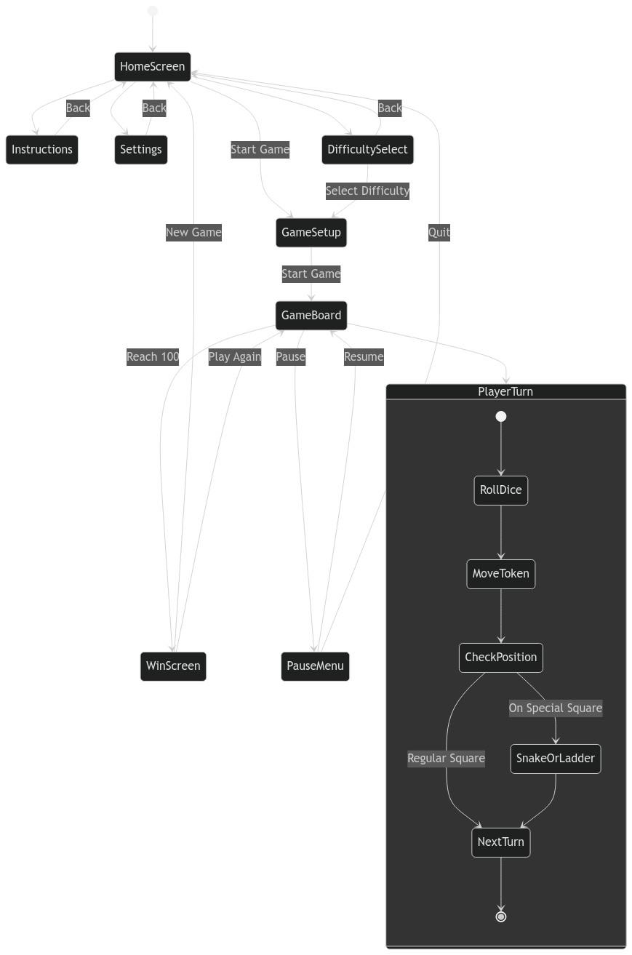
Wireframe and Layout Cont…
Wireframe
Game Title
Start Game
Settings
Instruction
Update
Game Board
Game Workflow

Slide 8
Code Explanation – Frontend (HTML/CSS)
Homepage Code:
HTML structure for buttons and layout.
CSS Grid for page structure and responsiveness.
Game Board:
CSS for board layout, snake, and ladder visuals.
Player token movement animations.

Slide 9
Code Explanation – Backend (PHP)
Dice Rolling Logic:
Code snippet for handling dice rolls and player movement.
Explanation of the randomization process and its integration with player position tracking.
Real-Time Multiplayer Updates:
PHP code for handling real-time player movement and dice rolls in multiplayer mode.
Explanation of synchronization between two players using sessions.

Slide 10
Testing and Challenges
Testing:
Usability tests to ensure the interface is intuitive and gameplay is smooth.
Multiplayer tests for real-time interactions and performance on different devices.
Challenges:
Designing responsive game elements for both small and large screens.
Ensuring smooth animations and real-time updates for multiplayer games.

Slide 11
Conclusion
Summary:
Snakes and Ladders offers an interactive, fun adaptation of Snakes and Ladders.
Key achievements: Multiplayer mode, real-time updates, and an immersive user interface.

